Slide 1

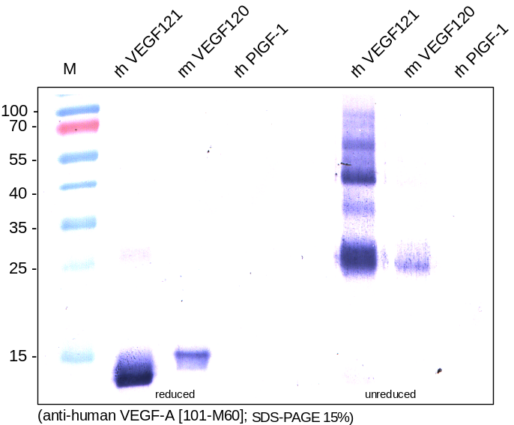
ReliaTech GmbH
Mouse anti-human VEGF-A
(Cat #101-M60)
Figure 1. Western analysis of reduced and unreduced recombinant human VEGF121 [Cat# 300-072], mouse VEGF120 [Cat# M30-032] and human PlGF-1 [Cat# 300-016] using a monoclonal mouse anti-human VEGF-A antibody [Cat# 101-M60]. There is a cross reactivity with mouse VEGF120 visible.
http://www.reliatech.de / orders@reliatech.de

